Slide 1
NAME: ABHIJAY S
DEGREE :B.TECH
BRANCH :3RD YEAR INFORMATION TECHNOLOGY
COLLEGE NAME:GOVERNMENT COLLEGE OF TECHNOLOGY
GMAIL-ID:abhi.71772118101@gct.ac.in
NM-ID:au71772118101
TNSDC_ GENERATIVE_AI Final Project
3/21/2024 Annual Review

Slide 2




PROJECT TITLE
FOOD DESCRIPTION BUILDER
3/21/2024 Annual Review

Slide 3



AGENDA
Step 1: Project Initiation and configuration using Google Collab
Step 2: Data Creation and Preprocessing
Step 3: Model Development using RNN and LSTM
Step 4: Evaluation and Testing
Step 5: Deployment and Integration
Step 6: Documentation and Knowledge Transfer
Step 7: Maintenance and Support
Step 8: Project Review and Closure

Slide 4


AGENDA
Fine-tuning T5 Model
Data Processing and Tokenization
Optimize Training Configuration
Configure training parameters to efficiently train the model for accurate kitchen description generation.
Specialize a pre-trained T5 model for generating kitchen descriptions by adjusting its parameters.
Prepare kitchen description and menu item data for training and tokenize it using the T5 tokenizer.
3/21/2024 Annual Review

Slide 5

PROBLEM STATEMENT
Description: Build algorithms to automate text generation for the kitchen type based on the menus that kitchen offers. The summary should be 2-3 lines in the mobile screen width.
For instance:
• This home chef specializes purely Punjabi dishes specifically country / village style dishes. Generally, these dishes are made with organic ingredients.
• This kitchen brings the best out of Keralite food, very authentic and delicious specials.
• Prema is passionate about making delicacies of Italian food and enjoys cooking unique culinary specials of Italy.
3/21/2024 Annual Review

Slide 6


PROJECT OVERVIEW
1. Instant Summaries: Users can instantly access concise summaries of kitchen types based on the menus they offer.
2. Tailored Insights: Summaries are tailored to fit within the constraints of mobile screen width, ensuring quick and easy consumption.
3. Culinary Specialties: Users gain insights into the culinary specialties of each kitchen, such as Punjabi, Keralite, Italian, and more.
4. Informed Choices: These summaries help users make informed choices when selecting dining options, matching their preferences and cravings.
5. Enhanced Dining Experience: By discovering kitchens that offer authentic and delicious dishes aligned with their tastes, users can enhance their dining experience.
6. Convenience: The algorithm provides a convenient way for users to explore diverse kitchen types and find the perfect dining destination.
3/21/2024 Annual Review

Slide 7

WHO ARE THE END USERS?
1.Restaurant Owners/Chefs: They may use the generated kitchen descriptions to create attractive and informative menus for their customers.
2.Restaurant Staff: Waiters and waitresses might utilize the generated descriptions to better understand and present menu items to customers.
3.Customers: End customers visiting the restaurant may benefit from the descriptive and informative menu items, helping them make informed choices about what to order.
4.Menu Designers: Professionals involved in designing menus for restaurants could use the generated descriptions as inspiration or reference for creating visually appealing menu layouts.
5.Food Critics/Bloggers: Individuals writing reviews or blog posts about restaurants and their menus may find the generated descriptions useful for conveying the essence and appeal of different dishes.
6.Recipe Developers: Those developing new recipes might find inspiration in the generated kitchen descriptions for creating unique and innovative dishes.
7.Food Enthusiasts: Individuals passionate about cooking or exploring new cuisines may enjoy reading the descriptive menu items for inspiration or entertainment purposes
3/21/2024 Annual Review

Slide 8

MY SOLUTION AND ITS VALUE PROPOSITION
Solution:
The text generation algorithm for kitchen types automates the process of summarizing culinary offerings based on menus. By analyzing menu data, it generates concise descriptions of each kitchen's specialties, enabling quick insights into the diverse cuisines available.
Value Proposition:
1. Time Efficiency: Instantly access succinct summaries of kitchen types, saving time and effort in researching dining options.
2. Informed Decision-Making: Make informed choices by understanding the culinary specialties of each kitchen, ensuring a satisfying dining experience.
3. Personalized Recommendations: Discover kitchens tailored to individual tastes and preferences, enhancing the likelihood of finding enjoyable dining experiences.
4. Convenience: Enjoy a streamlined process of exploring diverse culinary options, making it easy to discover new and exciting dining destinations.
5. Authenticity Assurance: Trust in the algorithm's ability to highlight kitchens offering authentic and delicious dishes, guaranteeing memorable culinary experiences.
3/21/2024 Annual Review

Slide 9

THE WOW IN MY SOLUTION
Custom Dataset Handling:
This feature facilitates easy integration of diverse datasets into machine learning pipelines. For instance, it can automate the generation of product descriptions in e-commerce, ensuring efficient utilization of data.
Fine-tuning Pre-trained Models:
By fine-tuning pre-trained models, users can leverage existing knowledge for specific tasks, especially in scenarios with limited labeled data. This approach is valuable for automating tasks like medical report generation in healthcare.
Training Configuration Optimization:
Optimization of training parameters maximizes model performance while managing computational costs effectively. This is crucial, particularly in tasks such as sentiment analysis of customer feedback in financial services, ensuring timely and cost-effective analysis.
3/21/2024 Annual Review

Slide 10
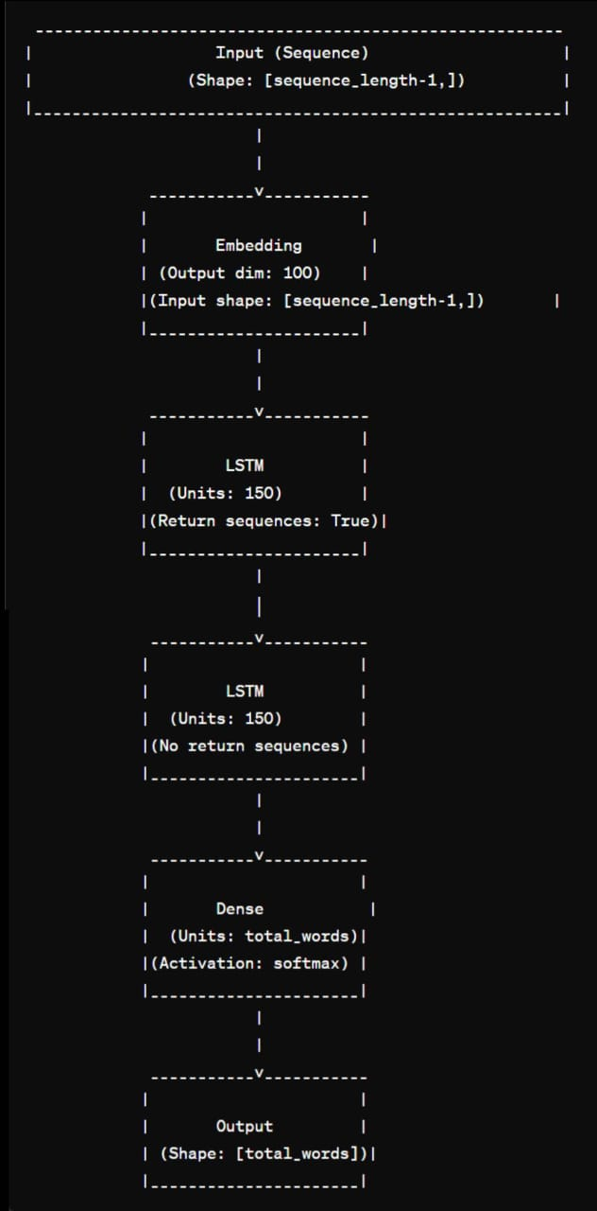
MODELLING
3/21/2024 Annual Review

Slide 11
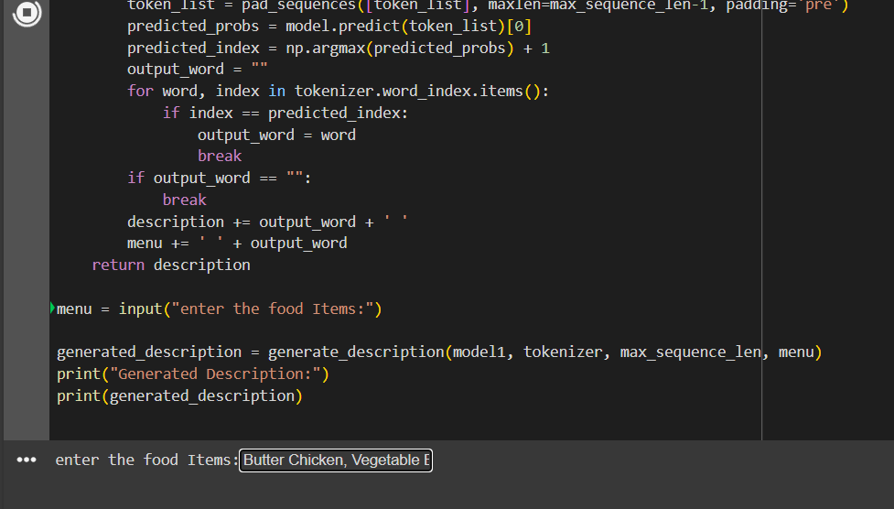
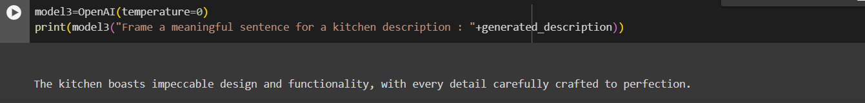
RESULTS
Link:
https://github.com/Abhi-213/TNSDC_-GENERATIVE_AI---Food-Description-Builder-Project.git
3/21/2024 Annual Review

